Slide 1

Theme
Mosaic
“Мост математике”
“Средња стручна школа” Kragujevac

Slide 2
Authors of the project:
Đorđe Petrić I grade
Đorđe Đorđević I grade
Aleksandar Desivojević II grade
Mina Narandžić III grade
Dušan Đorđević IV grade
Technial support Ilija Milivojević and Dimitrije Arsenijević I grade
Mentors:
Snežana Trifunović and Nataša Cvetić, mathemathics teachers,
Ivana Radović and Radomir Brzaković, mathematics and informatics teachers,
Aca Đokić, master of mathemathics
Project start and end date: 25 Dec. 2019 – 15 Jun. 2020

Slide 3
Problem:
Tiling a plane
Goal:
Creating a model of a solar panel
Project outcomes:
The student will be able to: Calculate the area and volume of a square; Create solar panels by applying their mathemathical knowlege; Use a variety of software tools
The student will be able to: Overcome the barriers of differences in age and interests through teamwork;
Achieve the transfer of knowledge through peer education;
Communicate responsibly and creatively
The student will be able to: Develop environmentally and socially responsible awareness;
Expand their level of digital literacy;
Apply the acquired knowledge in future research

Slide 4
Corelation:
Mathemathics, Computing, Informatics and Physics
Cross-curricular competencies :
Digital competence,
problem solving, cooperation and
responsible attitude in a democratic society
Project outcomes:
The student will be able to: Calculate the area and volume of a square; Create solar panels by applying their mathemathical knowlege; Use a variety of software tools
The student will be able to: Overcome the barriers of differences in age and interests through teamwork;
Achieve the transfer of knowledge through peer education;
Communicate responsibly and creatively
The student will be able to: Develop environmentally and socially responsible awareness;
Expand their level of digital literacy;
Apply the acquired knowledge in future research

Slide 5
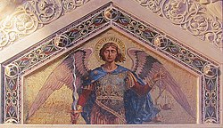
Project plan
The students conducted a mini-research of the history of mosaics and came to the following facts:
- A mosaic is a piece of art or a painting made up entirely of small pieces of stained glass or other material
Mosaics have a long history. They make a first appearance in the third millennium BC. in Mesopotamia.
They are widely used in religious structures. They were neglected during Islamic culture in the 8th century.
Mosaic of the Archangel Michael
(Serbian Church of St. Spyridon in Trieste)
- Mosaics are often used as interior decor

Slide 6
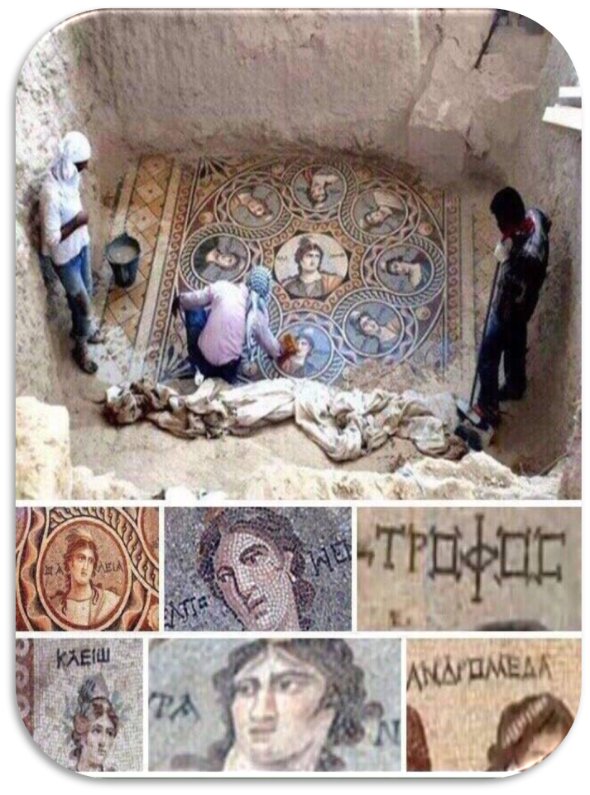
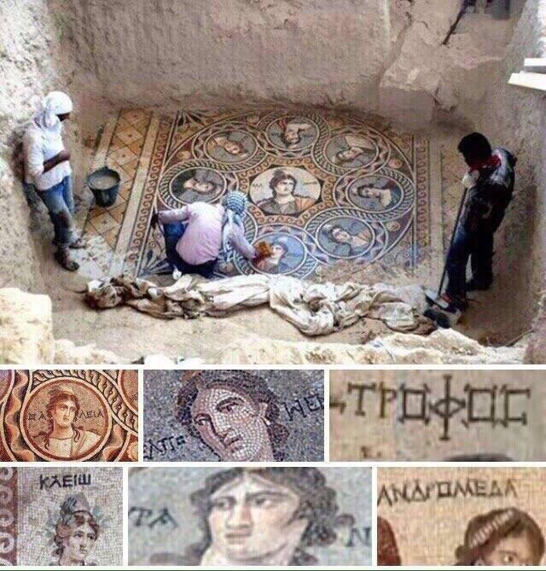
We researched...
In the city of Zagrumi in the south of Turkey, archaeologists found Cyrillic inscriptions in the Old Serbian language on the discovered mosaic.
It is assumed that this city was founded by Alexander the Great.
This is proof that Serbian history does not begin with the Nemanjić family, but has existed long before.

Slide 7
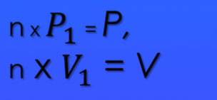
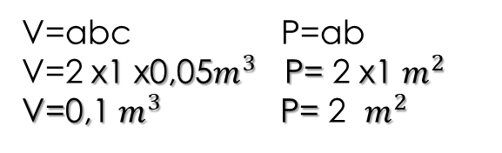
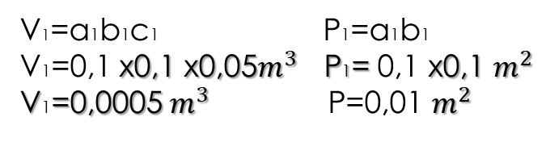
They were given the task to devise how they could apply the mosaic principle in practical, everyday life and came up with the idea:
Solar panel
A solar panel is a panel designed to absorb the sun's rays as a source for producing electricity.
The idea is:
Fill in a square measuring 2m x 1m x 0.05m with smaller squares measuring 10cm x 10cm x 5cm.
that is…
V=abc P=ab
V=2 x1 x0,05$m^{3}$ P= 2 x1 $m^{2}$
V=0,1 $m^{3}$P= 2 $m^{2}$
V1=a1b1c1 P1=a1b1
V1=0,1 x0,1 x0,05$m^{3}$ P1= 0,1 x0,1 $m^{2}$
V1=0,0005 $m^{3}$ P=0,01$m^{2}$
We found several ways to form a model of this solar panel:

Slide 8

We found out…
Theoretical calculation of efficiency limits for solar cells
In recent years, intensive work has been done on research into the development of high-efficiency solar cells, relying on new materials and structures. All this has led to a continuous record of the highest efficiencies achieved using various technologies. Since the first photovoltaic devices were developed, the most common concern is for all types of efficiency losses that prevent the achievement of physical limits. To overcome this hurdle, in-depth investigations have been conducted to control their origin in order to identify potential efficiency benefits. Numerous thermodynamic approaches have been used to calculate the efficiency limit of solar cells, ranging from the ideal Carnot motor to the latest detailed balance with improved access.
The aim is to present an overview of the techniques used to calculate the convertibility efficiency limits for solar cells, with a detailed calculation using a number of numerical techniques. The study consists of an analysis of the internal losses of a solar cell. Several theoretical approaches have been used to obtain the thermodynamic limit for conversion to energies.
To present a more realistic picture of a solar cell, it is necessary to take into account three other basic factors, namely; solar viewing factor seen from the position of the solar cell, background radiation that could be represented as a black body at room temperature and loss due to recombination, radiation and non-radiation

Slide 9
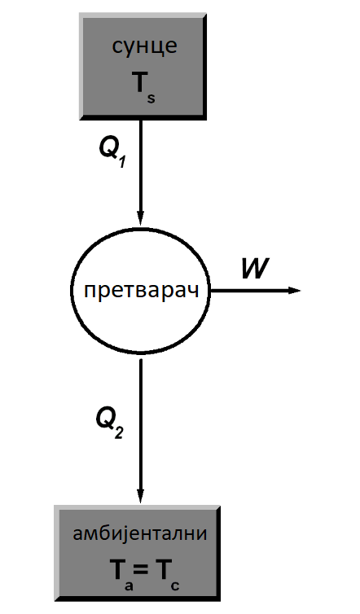
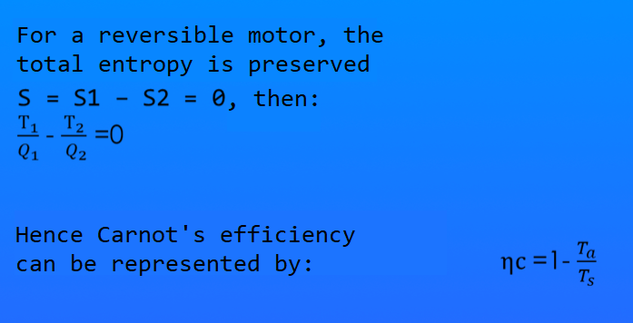
Schematic diagram of a solar converter presented as an ideal Carnot motor
This efficiency simply depends on the ratio of the temperature of the inverter, which is equal to the temperature of the surrounding cooler and the temperature of the sun. This efficiency is maximum (ηc = 1) if the temperature of the converter is 0 K and solar energy is completely converted into electrical work, while ηc = 0 if the temperature of the converter is identical to that of the sun Ts, the system is in thermal equilibrium, no energy exchange. If the sun is at a temperature of 6000K and the ambient temperature is 300K, the efficiency of Carnot is 95%, this value represents the upper limit for all solar inverters.

Slide 10
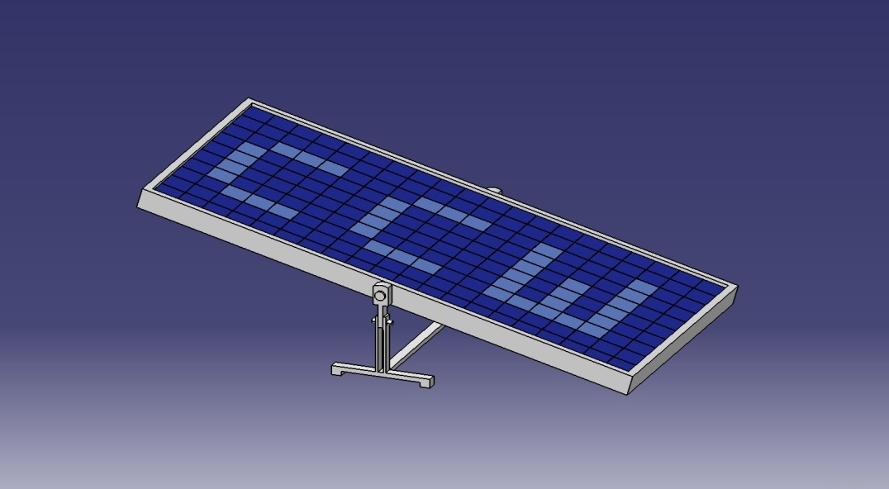
CATIA V5
By using the CATIA V5 program, a model of a solar panel was constructed. The model consists of six details, individually constructed.
construction of a frame 3 cm thick,
fixed holder,
a carrier which serves as a support for the panel,
two rivets,
the last constructed detail is a small panel measuring 1dm X 1dm.
In the next step, we joined the details one by one using the “Assembly design” using the carrier as the fixed base. We joined the carrier and the fixed holder with the first rivet, then assembled them with the frame of the panel using the second rivet. We then added one small plane to the corner of the frame and multiplied the command to cover the inside of the frame. There are a total of two hundred small planes and together they form a solar panel measuring 2m x 1m. In the end, we painted the final model with the appropriate colors.

Slide 11
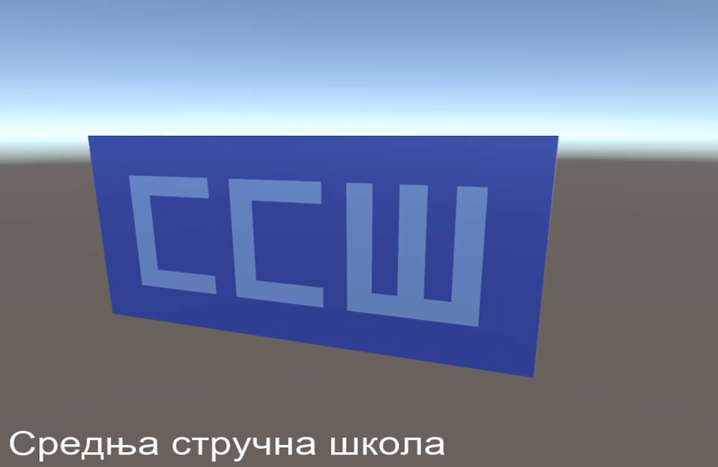
Unity 3D
With the help of Unity 3D, we were able to create an animation to fill the solar panel
We created a large panel using the “3D Object” command and used it to form a 3D model of a cube. Clicking on the cube opens its specifications on the side and there we adjust the dimensions to make a square measuring 1dm x 1dm. After that we created a large panel measuring 2m x 1m. We created 3 new materials using the “Create> Material” option in the Project tree to set a specific color for each material. The first material is for a large gray panel, while the other two materials are for the two shades of blue. We set up the animations by selecting the desired model and opening the Animation window. Inside it, we set the start point and end point with their coordinates. We adjusted the speed of the animation by clicking on the model, after adding the animation, an additional window “Animator “ opens, where clicking on the name given for the animation opens yet another window where we can adjust the speed and additional parameters related to that model. We set up the “ССШ” by assigning specific materials to the specific squares, which are lighter in color and which we had previously created. By repeating these steps, we create 200 squares with animations. They create the final animation shown on the next slide which is recorded using the OBS Studio recording program

Slide 12
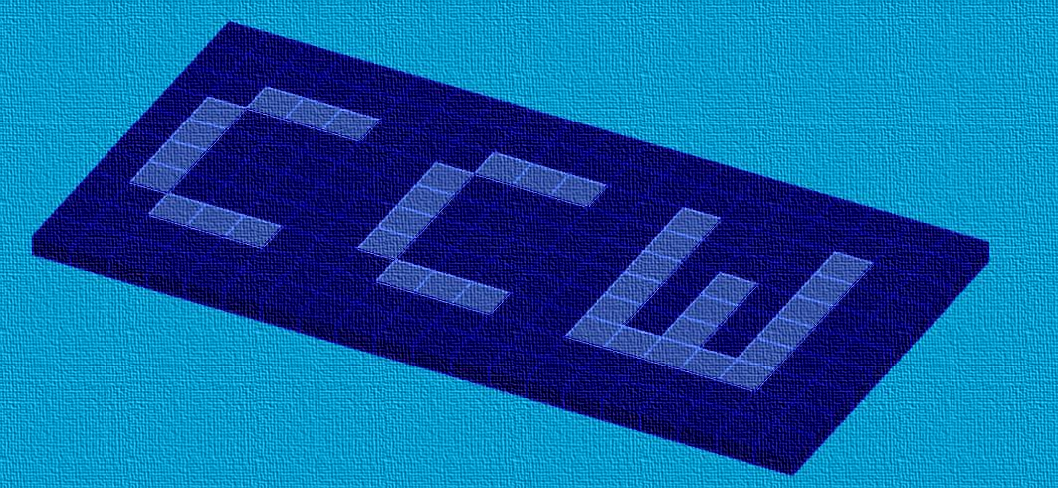
AutoCAD
We constructed this model in AutoCAD. We first changed the workspace to 3D Basics. Using the "Box" command, we created a body measuring 1 dm x 1 dm x 0.5 dm. With the “Array” command, we multiplied the body to form a panel measuring 1 m x 2 m x 0.05 m. We changed the color, made a new Layer in which we change the color of certain 1x1 planes that form the letters “ССШ”. Finally, we change the Visual style, in order to get a more realistic look of is model.

Slide 13
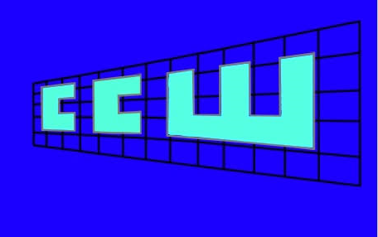
The panel model is presented on the grid of squares as a 3D presentation which prints the initial letters, ie. the abbreviation of the name of our school “СРЕДЊА СТРУЧНА ШКОЛА”
“ССШ” 3D-PRESENTATION:
The letters appear one by one until the entire abbreviation has appeared - ССШ

Slide 14
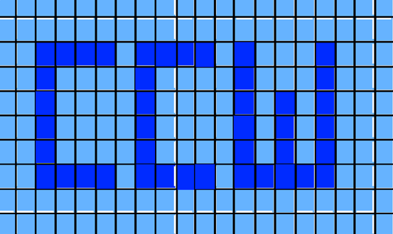
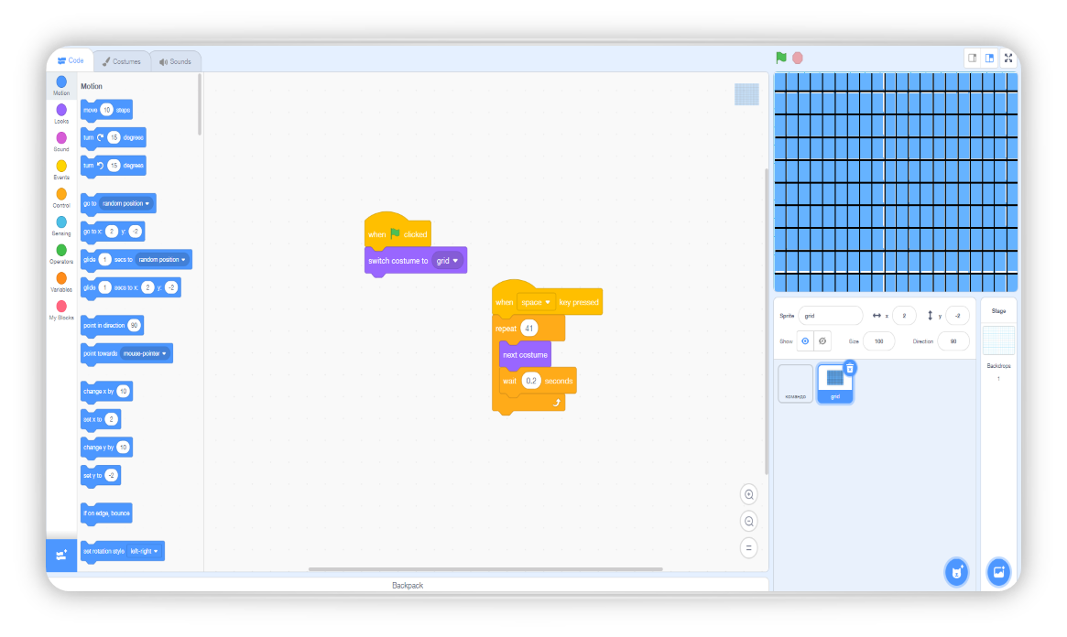
The software is activated by the command "Space" on the keyboard where its functionality creates the text “ССШ” in pixels. The project is determined on Scratch. The print is made for a solar panel that shows “ССШ” on it.
We used the following "When flag clicked" commands, then we merged "Switch costume to grid". Finally, a new block "When space key pressed" is added, so we connected with "Repeat 41". We add "Next costume" and also "Wait 0.2 seconds".

Slide 15
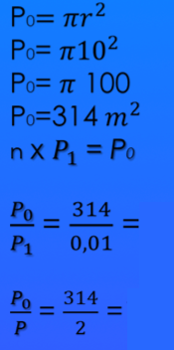
We came to the conclusion:
The area of the part of the school yard that we want to cover, in the shape of a circle, with a radius of 10m, we calculated:
31400 mini-panels
157 big panels
Maximum covered area equal to our solar panel models is more economically viable if we use mini-panels, but, bearing in mind that they should contain a component of our school initials, it was decided by democratic vote that the school logo be represented in next project implementations.

Slide 16

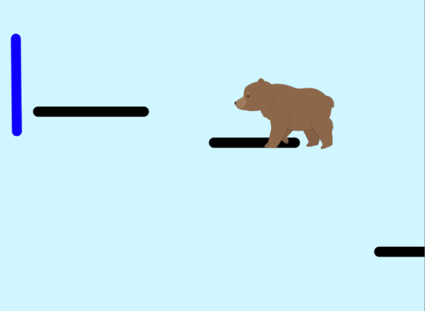
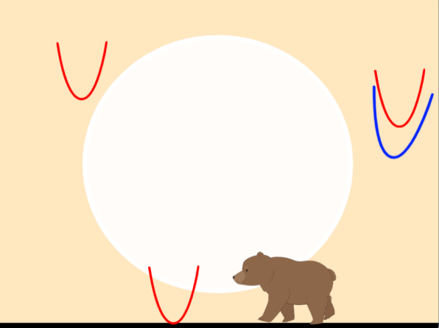
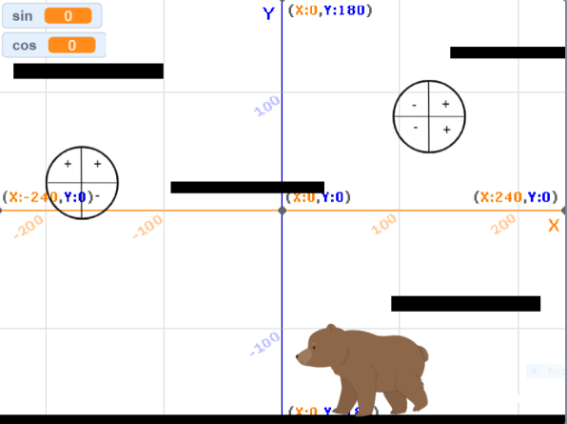
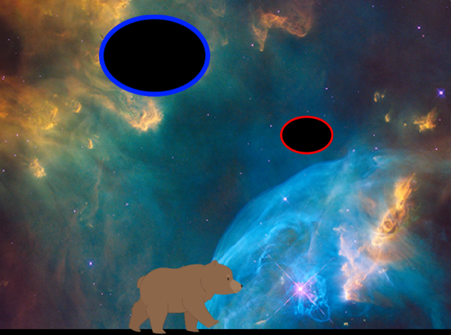
Skratch
We formed a mosaic in the game that consists of 4 levels. Each level is based on one of the 4 seasons. In the first level, all lines must be collected. When you collect them, they merge and form a right triangle. In the next level you avoid the red and catch the blue parables. In the third level, you avoid clouds that represent ellipses. To pass the last level you have to catch sin and cos.

Slide 17
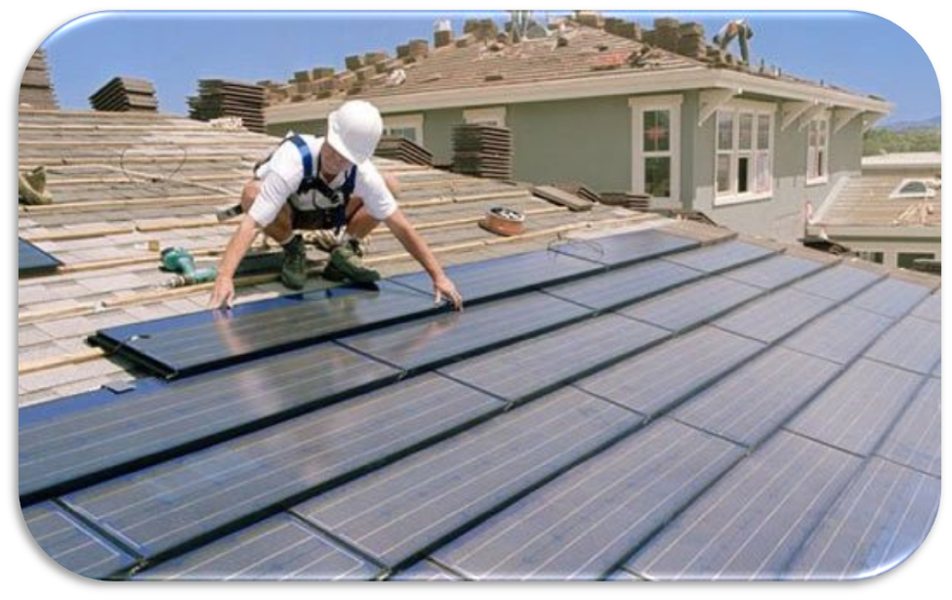
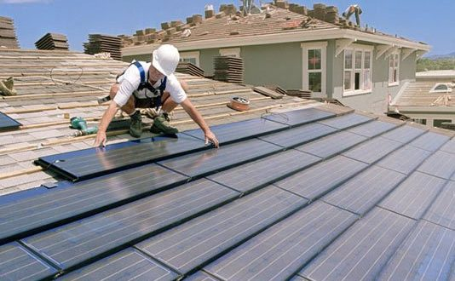
ž
WE RESEARCHED...
Elon Musk recently introduced the solar tile, which in his vision of the future, should replace the ugly solar panels on roofs and announced that their solar roof will be cheaper to manufacture and install than a traditional roof.
Musk expects that the savings will come with the delivery of goods. The traditional tile is heavy, bulky and brittle.
Musk’s tile is a fifth lighter than a classic roof tile and easier to transport.
This tile is made of glass and looks almost the same as the classic one, but it also produces electricity.
The original question is: "Do you want a roof that looks better, lasts twice as long, is cheaper and produces electricity?"

Slide 18

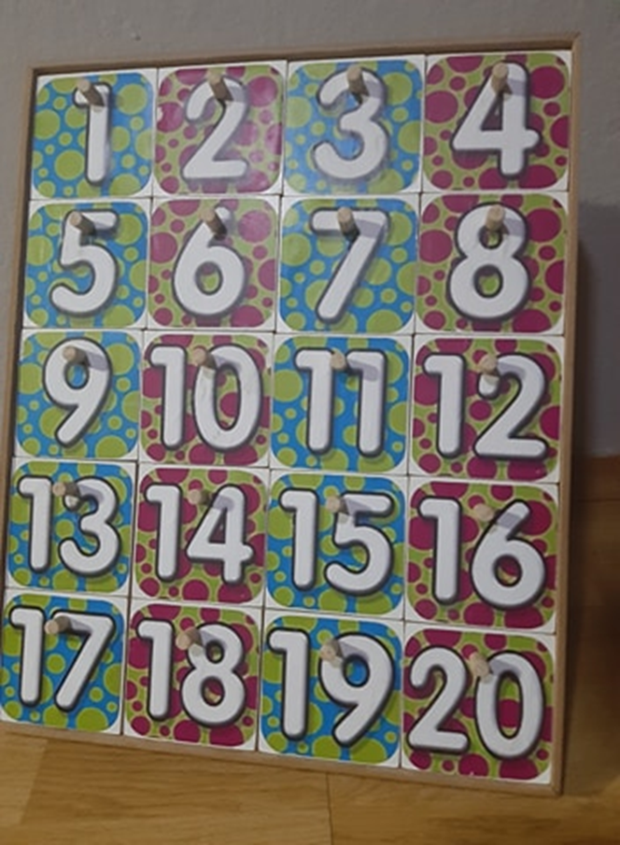
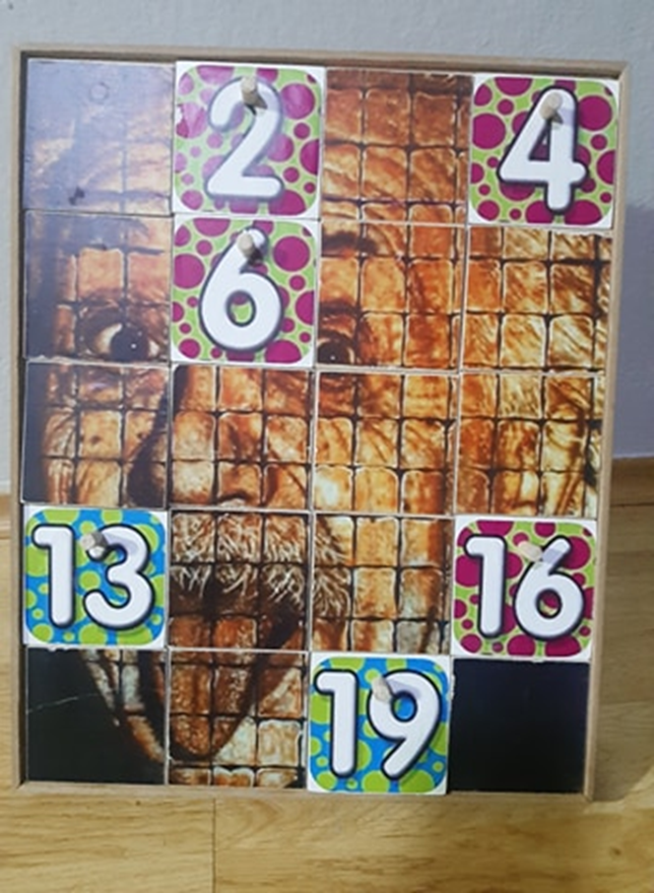
OUR MOSAIC
A board game - implementation in teaching
We created a game consisting of 20 planes. Each plane has one number on one side and a part of the image on the other
Each number has it’s own question. The contestant chooses a number and gets a question. When the contestant answers correctly, he turns the plane and thus reveals a part of the picture.
Questions can be adapted
any teaching material.
The goal of the game is to guess what is in the photo with as few open planes as possible

Slide 19
Sources
Software programs:
Concepts:
CATIA V5
Unity 3D
Paint.NET
Adobe Premiere Pro
Scratch
OBS Studio
HandBrake
Mosaic #1
Mosaic #2
Mosaic #3
Solar panel#1
Solar panel #2
Solar panel #3
“Збирка решених задатака из математке, за први, други, трећи и четврти разред средње школе”, Vene Bogoslavov
“Математика за средње школе (4. часа)”
Authors: Miličić Pavle, Boričić Branislav, Stojanović Vladimir,
Kadelburg Zoran: Kadelburg Zoran, Miličić Pavle, Boričić Branislav,
Stojanović Vladimir
Link for the formulas: https://www.intechopen.com/books/solar-cells-new-approaches-and-reviews/theoretical-calculation-of-the-efficiency-limit-for-solar-cells

